Slide 1

Computer Games Künstliche Intelligenz
Verhaltensmodelle
Michael Widjaja

Slide 2
Reference
Craig Reynolds. 1987. Flocks, herds and schools: A distributed behavioral model. SIGGRAPH Comput. Graph. 21, 4, 25-34
Craig Reynolds. 1999. Steering Behaviors For Autonomous Characters. Proc. Game Developers Conference 1999, 763-782
http://gamedevelopment.tutsplus.com/
http://www.red3d.com/cwr/steer/

Slide 3
Einführung in Verhaltensmodelle
Our Foreflocks
Actors and Distributed Systems
Particle Systems
Behavioral Animation
Geometric Flight
Banking
Boids and Turtles
Simulated Flocks
Arbitrating Independent Behaviors

Slide 4
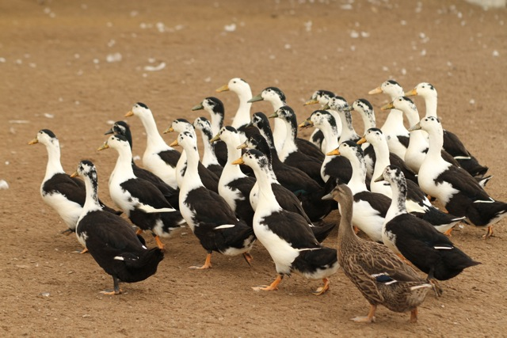
Our Foreflocks
http://curtalefarm.files.wordpress.com/2010/08/ducks_3151.jpg

Slide 5
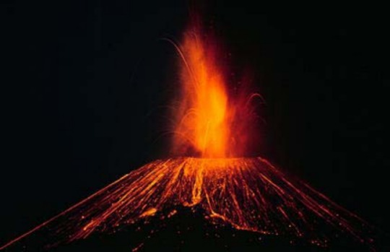
Particle Systems
http://2.bp.blogspot.com/_iD-2uaXrmVM/TO4gqXQh8sI/AAAAAAAAAHs/Ux7q3fAAD9M/s1600/paricutin2.jpg

Slide 6
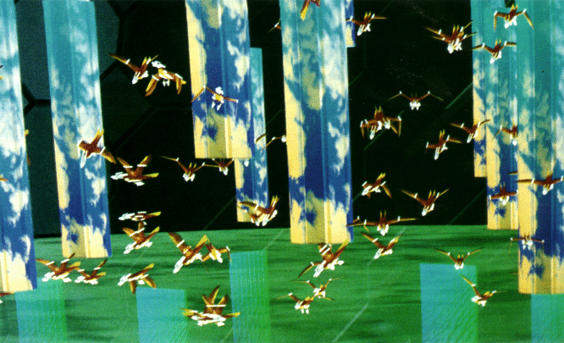
Actors and Distributed Systems
https://www.macs.hw.ac.uk/~dwcorne/Teaching/Craig%20Reynolds%20Flocks,%20Herds,%20and%20Schools%20A%20Distributed%20Behavioral%20Model_files/cwr87p1.gif

Slide 7
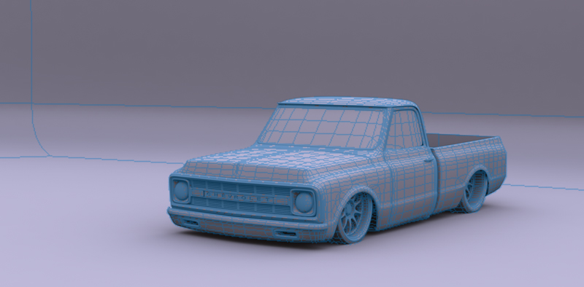
Behavioral Animation
http://www.carterhickmandesigns.com/junk/clay.jpg

Slide 8
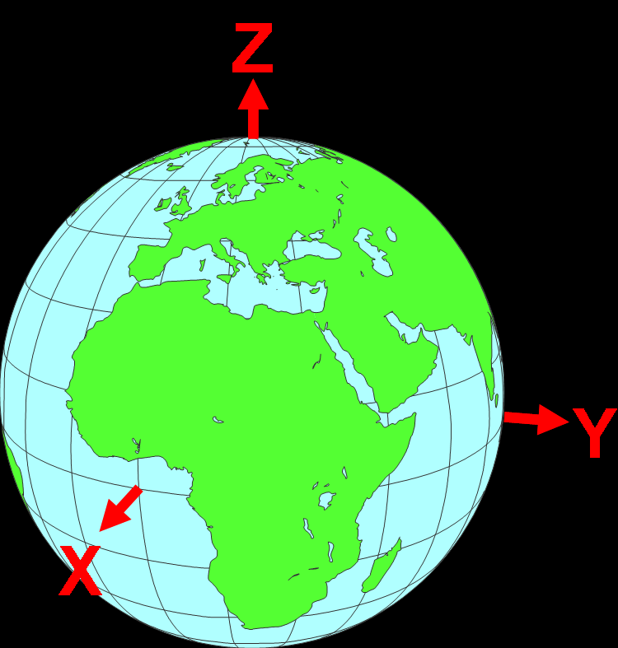
Geometric Flight
http://www.hydrometronics.com/images/world_xyz.png

Slide 9
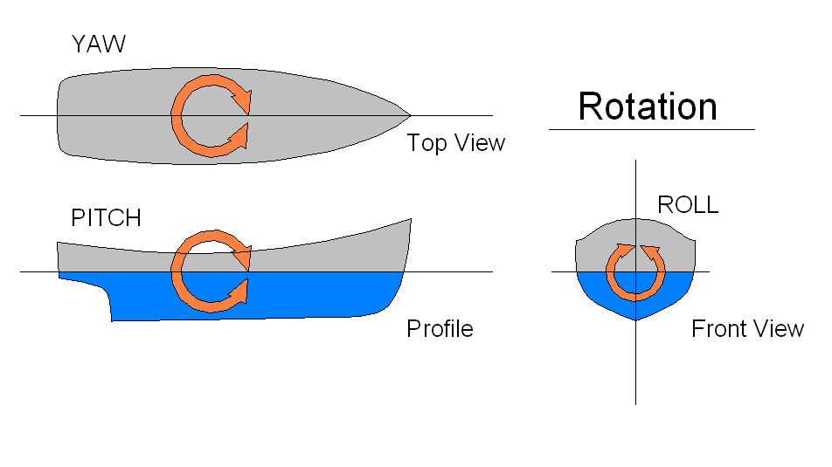
Banking
http://upload.wikimedia.org/wikipedia/commons/d/df/Rotations.png

Slide 10
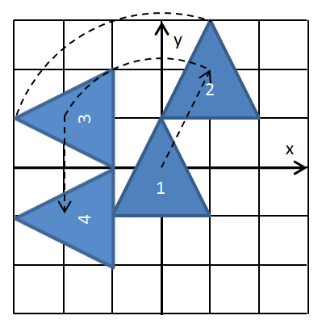
Boids and Turtles
http://i.stack.imgur.com/emATu.png

Slide 11
Simulated Flocks
1. Collision Avoidance: avoid collisions with nearby flockmates
2. Velocity Matching: attempt to match velocity with nearby flockmates
3. Flock Centering: attempt to stay close to nearby flockmates

Slide 12
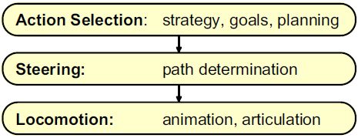
Arbitrating Independent Behaviors

Slide 13
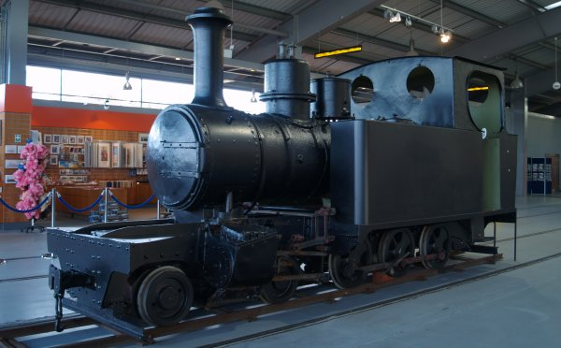
Locomotion
“converts control signals from the steering layer into motion of the character’s ‘body’.”
http://www.docbrown.info/docspics/northeast/P1251016.jpg

Slide 14
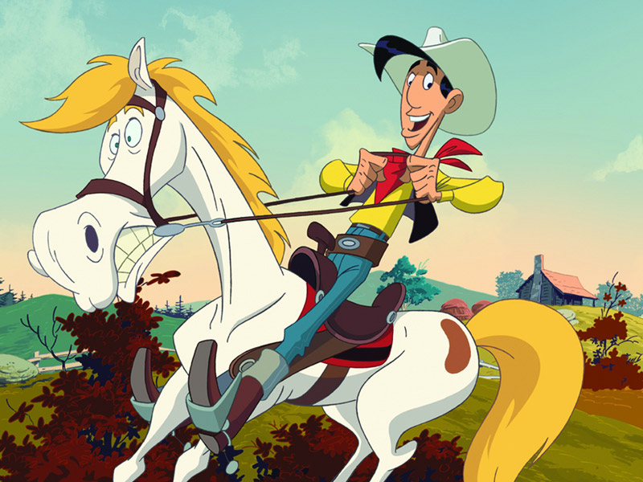
Beispiel von „Motion behaviors“
http://img.bluray-disc.de/files/review/big__Lucky-Luke-Review01.jpg

Slide 15
Steering Behaviors
Steering
seek and flee
pursuit and evasion
offset pursuit
arrival
obstacle avoidance
Wander
wall following, containment
flow following
unaligned collision avoidance
Separation, cohesion, alignment
Path following

Slide 16
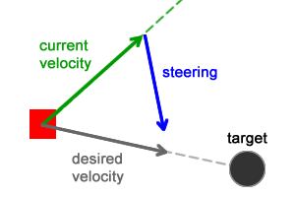
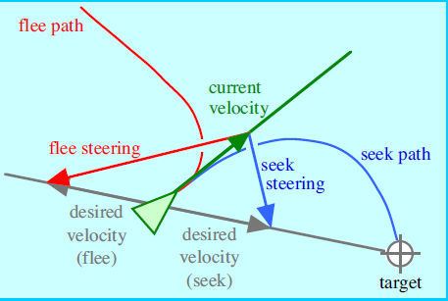
Seek and Flee
Position = position + velocity
velocity = normalize(target - position) * max_velocity
steering = desired_velocity – velocity
desired_velocity = normalize(target - position) * max_velocity

Slide 17
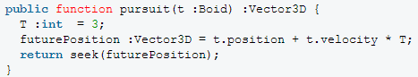
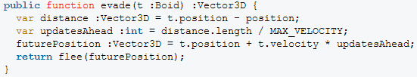
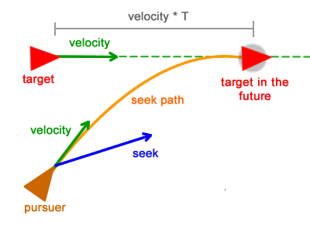
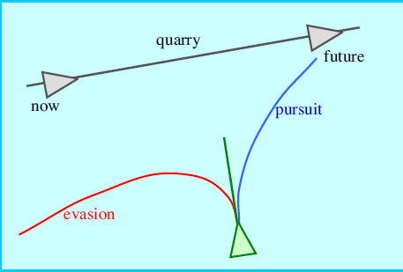
Pursuit and Evasion

Slide 18
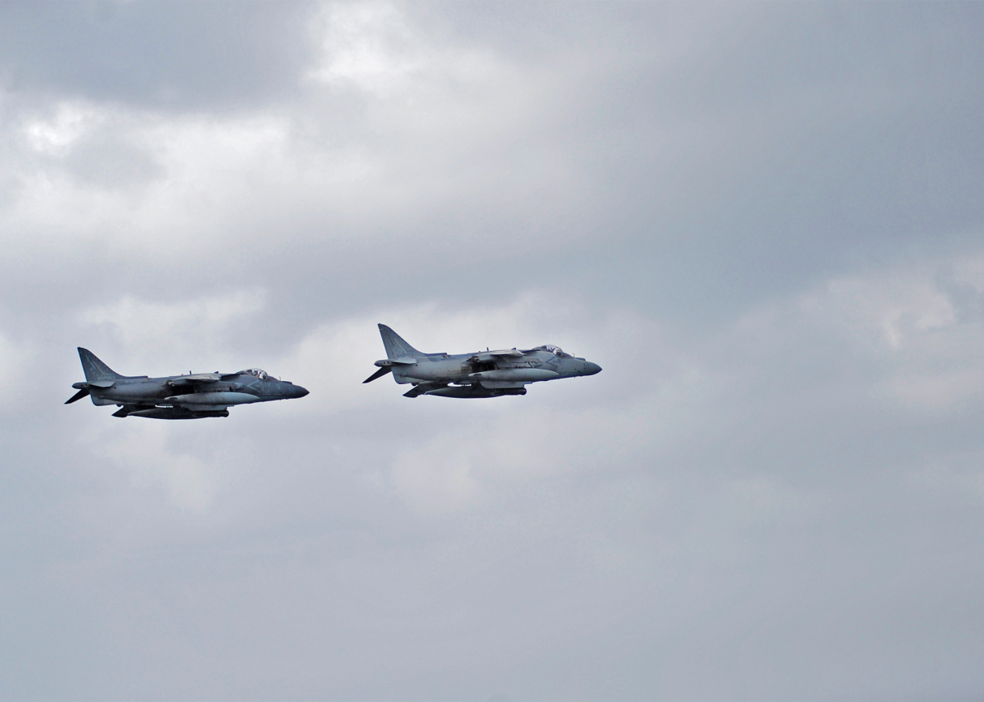
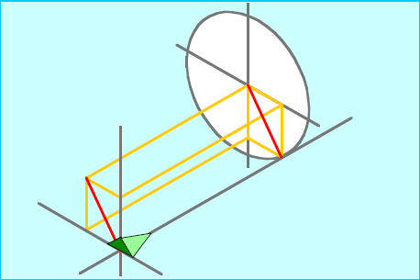
Offset pursuit

Slide 19
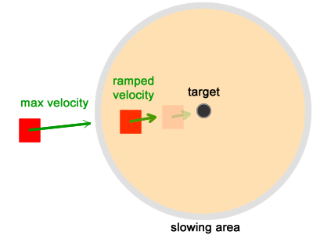
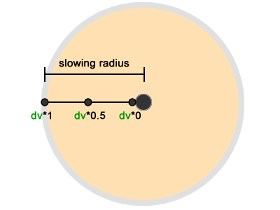
Arrival

Slide 20
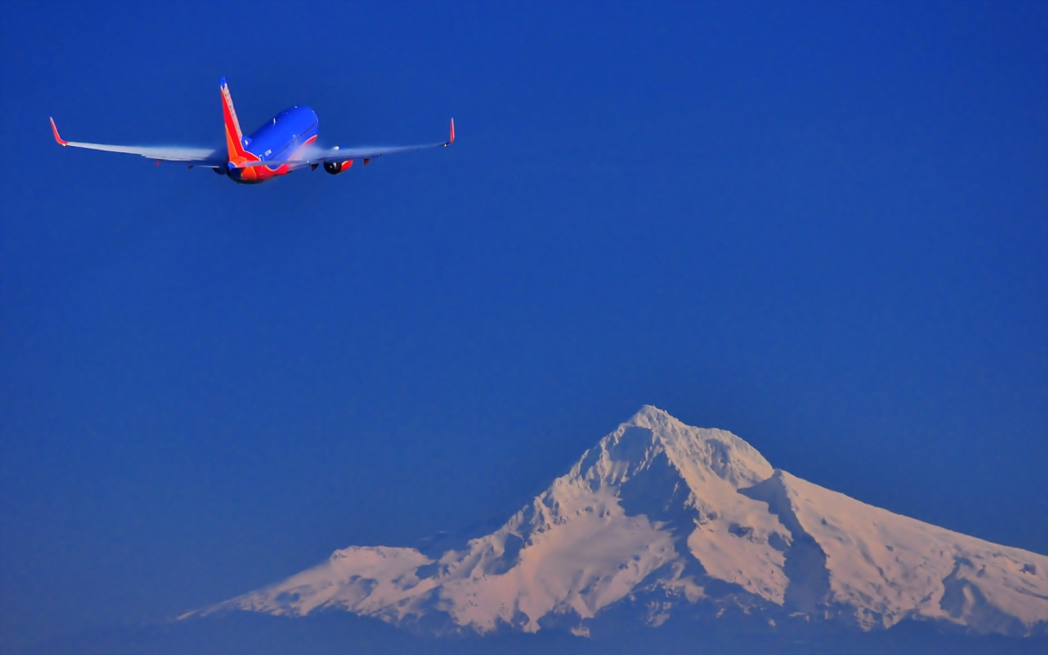
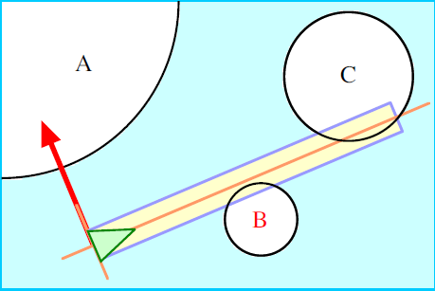
Obstacle Avoidance
http://st.gdefon.com/wallpapers_original/wallpapers/430077_samolyot_nebo_gora_1680x1050_(www.GdeFon.ru).jpg

Slide 21
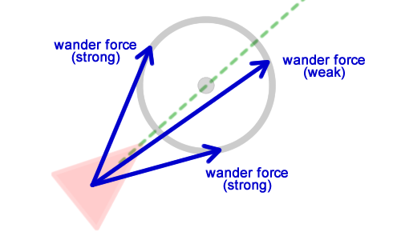
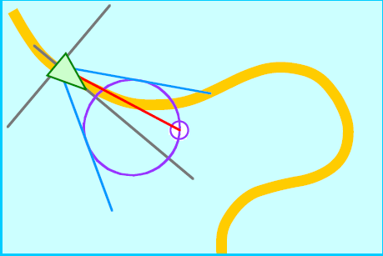
Wander
Seek and Randomness → “random walk”

Slide 22
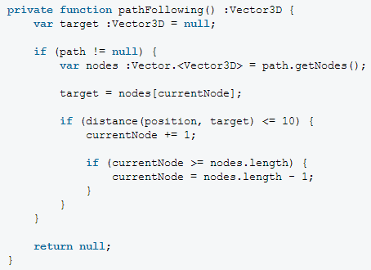
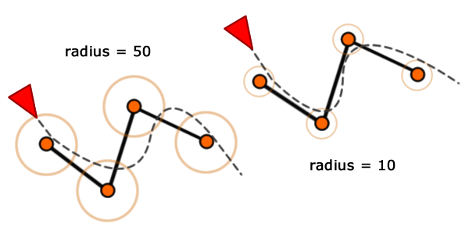
Path following

Slide 23
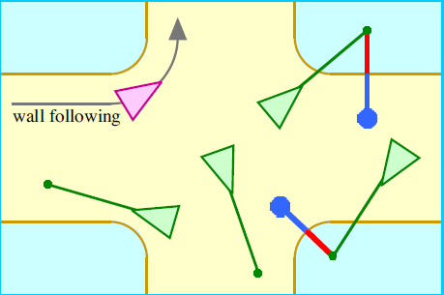
wall following / containment
Variations on path following include wall following and containment
Containment refers to motion which is restricted to remain within a certain region
Wall following means to approach a “wall” (or other surface or path) and then to maintain a certain offset from it

Slide 24
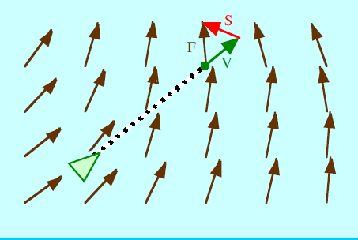
Flow field following
In flow field following behavior the character steers to align its motion with the local tangent of a flow field (also known as a force field or a vector field).

Slide 25
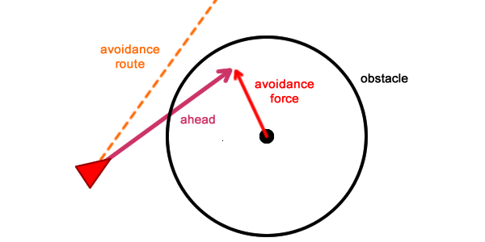
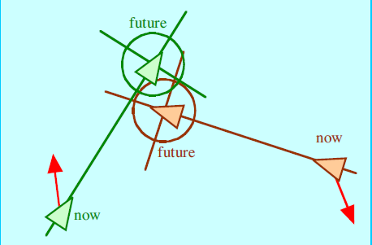
Unaligned collision avoidance
Unaligned collision avoidance behavior tries to keep characters which are moving in arbitrary directions from running into each other.

Slide 26
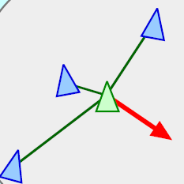
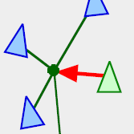
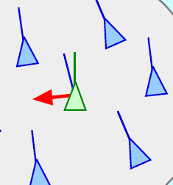
Separation, Cohesion & Alignment
Cohesion
Alignment
Separation

Slide 27
DANKE FÜR IHRE
AUFMERKSAMKEIT

